Slide 1
[
]
maWebcenter and Shopping Annuity
Market Singapore Leadership School Oct 2016

Slide 2

WE LIVE IN A DIGITAL AGE
  Where do you
  Get your news
  Socialise
  Research
  Find products
  Find services
  Play
  Get Music
  Get Books
  Get Periodicals
  Get Advice
Everyone is “Plugged in”.
If you think about it, we are all consumers of the internet in some way, shape or form!
Notes:
TRAINER’S NOTES:
Here are some talking points:
We are all consumers of websites in our every day lives. Think about where you read your news, socialize etc.
Would you agree that people are plugged in and get much of their information online?
Businesses need to be online so they can interact with their customers and potential customers
Customers have an expectation to be able to browse websites for products, information and services

Slide 3
THE MARKET CLIMATE: INTERNET
Notes:
TRAINER’S NOTES:
The internet is now a way of life.
Statistics show that people rely on the internet to make buying decisions

Slide 4

THE WORLD IS ONLINE
LOCAL BUSINESSES & ORGANISATIONS NEED SOLUTIONS TO COMPETE
Notes:
TRAINER’S NOTES:
In order to be relevant in today’s marketplace, business owners need a complete online solution
Without a full solution, they will not be able to reach consumers in a meaningful way
.

Slide 5


TRAFFIC
ABILITY TO MAKE CHANGES
SOCIAL MEDIA
ECOMMERCE
VISIBILITY ON GOOGLE
ANALYTICS
EMAILS, DOMAINS
SECURE HOSTING
EMAIL CAMPAIGNS
SUPPORT
BUT… THEY ALSO NEED
BUSINESS OWNERS NEED A GREAT WEBSITE
Notes:
TRAINER’S NOTES:
Introduces the idea of consumer confusion
Business owners are overwhelmed by:
All of the places they need to be online
All the choices they have to make it happen
It’s not just about having a website. You need website traffic!

Slide 6
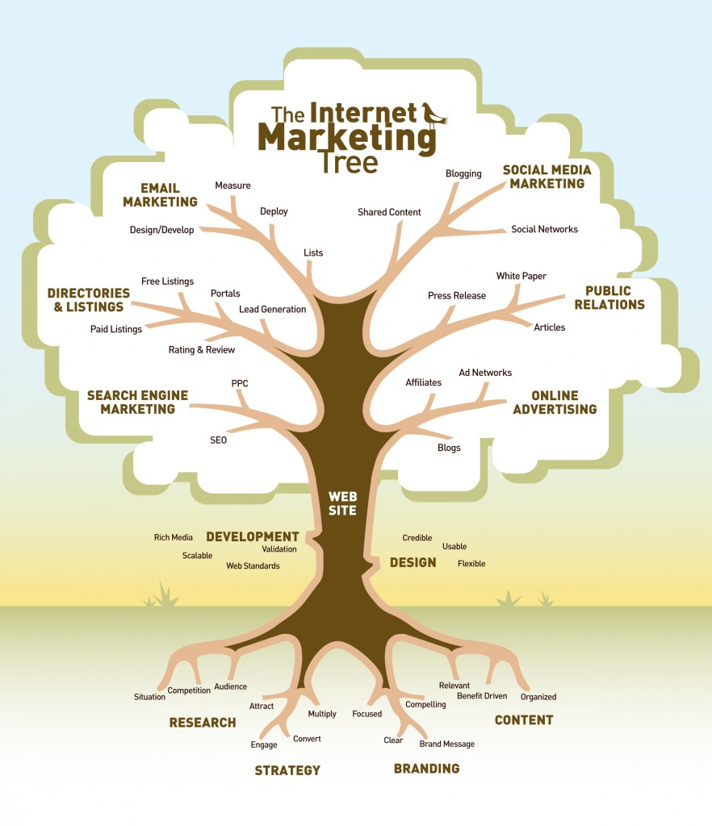
Having a solid good website is more important !
Notes:
Not matter how much you spend on your internet marketing budget, having a solid good website is still the key!

Slide 7

Responsive Websites
Website SOLUTION
Completely customiSable
Easy to edit / Drag & drop tools
LANDING PAGES, FORMS, LEAD CAPTURES
BUSINESS OWNER HAS COMPLETE CONTROL
SOCIAL MEDIA, SEO & OTHER TOOLS
Notes:
Trainers Notes:
This is just an intro slide – The goal here is to get them excited about what we are going to talk about.
In brief, cover the big topics “Websites, Marketing Tools, Unlimited, Support, Security)
The goal is to paint a simple picture of how all –inclusive our solution actually is / Instill confidence in the product.
Spend 1 minute or less on this slide – the details are coming up!

Slide 8


DESIGN CENTRE
Notes:
TRAINER’S NOTES:
Showcases Design Center work
Fully responsive sites (optimized for all devices)

Slide 9
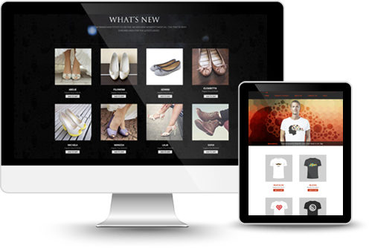
Master Online Selling with E-Commerce

Slide 10

eCommerce Tools
Configurable product options that adjust the sales price
  Order history with easy “Reorder” feature
  Shopper
  wish list
  Pan and zoom product image
  Compare products
  Multiple billing options
  Shopper product reviews
  Product tags
  Sales dashboard
  See who’s shopping
  Enhanced Product Catalogue search results with product thumbnails
Notes:
TRAINER’S NOTES:
Our e-commerce system is incredibly flexible.
There is so much which can be done with it.
(share some personal examples from your own client base).
(hit some of the highlights from the Features & Benefits).
Again, this is about providing an effective Internet presence. If the business owner’s current solution doesn’t allow for customer reviews or wish lists, is it an effective internet presence? Nope!

Slide 11

Marketing
Tools
SEO TOOLS
SOCIAL MEDIA TOOLS
CRM
EMAIL MARKETING
DOMAINS
EMAIL
Notes:
Trainers Notes:
Our e-commerce system is incredibly flexible.

Slide 12
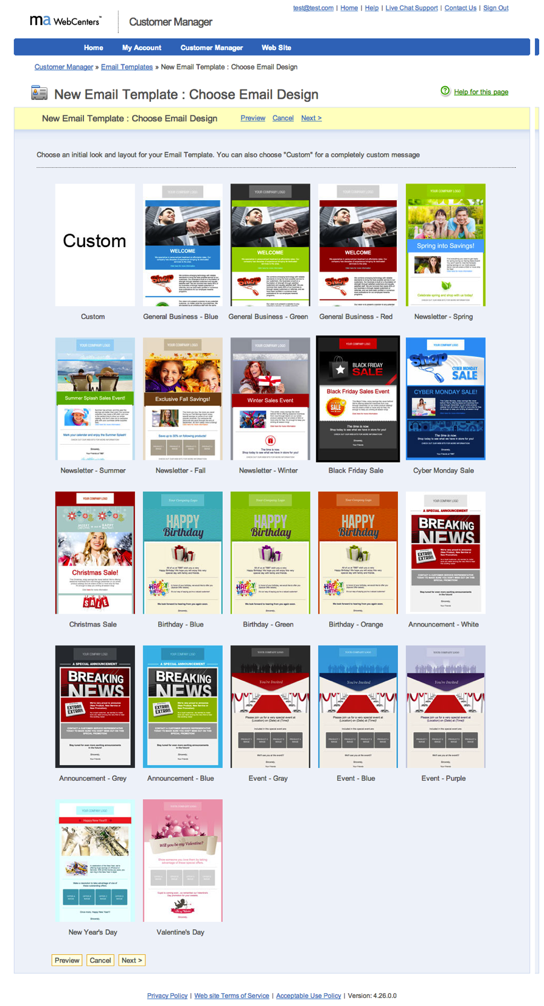
Email Marketing
Facebook
Website Builder
New Website Effects & Ecommerce Plugins
Notes:
Trainers Notes:
Facebook Website Builder Tool
Motives Trainer Templates
APN (Sell SHOP Products on your website)
EFFECTS: Pin to top, content can now fade, shake, scale, drop, pulsate, puff , Parallax
ECOMMERCE UPGRADES
Newsletter Coupon
Customer Loyalty Points
Chat Support
Stamps.com

Slide 13
Australia
Bahamas
Bermuda
Canada
Chile
China
Columbia
Costa Rica
Dominican Republic
Ecuador
Hong Kong
Indonesia
Ireland
Jamaica
Macau SAR China
Mexico
New Zealand
Panama
Philippines
Singapore
Spain
Taiwan
United Kingdom
United States
YOUR GLOBAL WEBCENTER
Your WebCenter is automatically enabled to sell websites globally in all
Market Countries & EMP Countries. You earn Home Country Retail Profit & BV!
Notes:
TRAINER’S NOTES:
What does that do for us?
First, by having websites which are completely in other languages and the entire back end of the system, including the menus and contextual help, the business owners who are more comfortable with another language will be able to take more effective use of the solution.
Second, by providing all the support, from sales to ongoing support with clients, all in multi-languages.
As a non-native speaker, you can probably find numerous business owners who you can have a short conversation to set an appointment with, but you wouldn’t be able to do a sales walkthrough because the business owner might not understand English well enough. This way, all you need to do is set the appointment, and let the team handle the rest for you!
And we all know that some of your best business prospects are business owners and customers of yours. This is a very natural way to lead to prospects for the business in a cultural market you might not have thought you could make inroads to.

Slide 14








The Power of Unlimited
Unlimited Pages
Unlimited Changes
Unlimited Traffic
Unlimited E-mail Address
Unlimited Upgrades
With unlimited support, changes and upgrades, having an effective online presence is simple.
AND NOW… UNLIMITED SPACE!
We take away the challenges that business owners face to stay current with their online marketing solution.
Notes:
Trainers Notes:
Self Explanatory

Slide 15


So now…
YOU
Can Provide
Professional
without owning a
Web Development Company

Slide 16


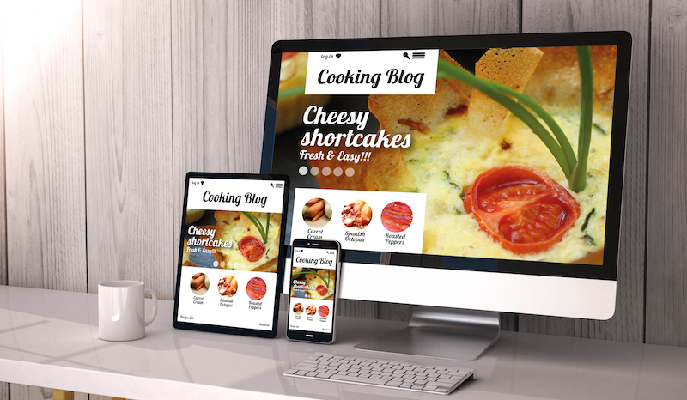
Proven system of success
YOU TALK WITH
BUSINESS OWNERS
AND SET AN APPT.
SALES TEAM
DESIGN, DIGITAL
SUPPORT TEAMS
CLIENT
GETS A GREAT SITE
AND SUPPORT MARKETING IT
Notes:
(1 minute)
Shows the simple sales system.

Slide 17
Let’s take a look at earning potential
example: ONE WEBSITE CLIENT (US$)
Avg. Retail Profit: $1,000
BV: 230 for initial sale
30 per month
Design, Digital &
Social Media Products:
Ongoing Retail Profits
& Business Volume
Business Relationship
ITEM | RETAIL PROFIT | BV
WEBSITE SALE | $1,000 | 200 BV 30/ MO.
DESIGN PACKAGE |  | 50 BV
SOCIAL MEDIA MANAGEMENT | $15/ MO. | 20 BV/ MO.
PREMIUM FACEBOOK ADVERTISING | $10/ MO. | 15 BV/ MO.
BASIC GOOGLE ADVERTISING | $24/ MO. | 24 BV/ MO.
TOTAL INITIAL SALE | $1,049 | 339 BV
TOTAL RECURRING | $49/ MO. | 89 BV/ MO.
PRODUCT PRICING, BV AND RETAIL PROFITS: WWW.MAWC411.COM/SUPPORT.HTML
Notes:
TRAINER’S NOTES:
Take a look at what the Digital Marketing Products generate
Remember, full pricing and BV is available on mawc411.com/support.html

Slide 18

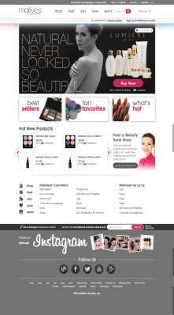


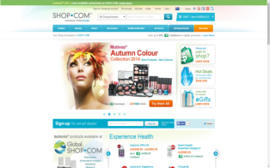
Our Clients are Business Owners
Help business owners with their overhead / expenses
sg.shop.com/chwen
Build share of customer with other ma products
SMB Owners =
Entrepreneurs/UFO Prospects

Slide 19

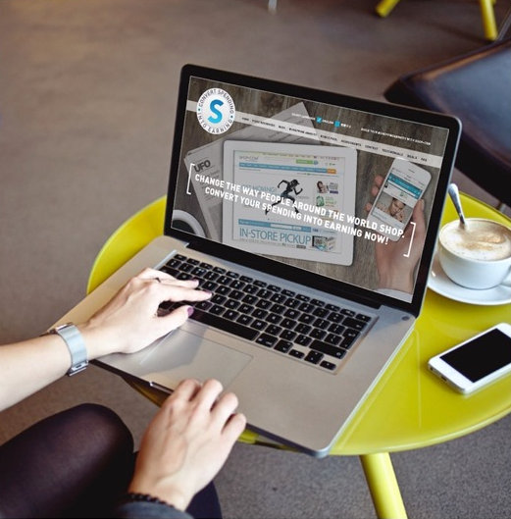
Position Yourself for Success
BUSINESS OWNERS
ONLINE/MOBILE SHOPPING
SHOPPING ANNUITY™

Slide 20
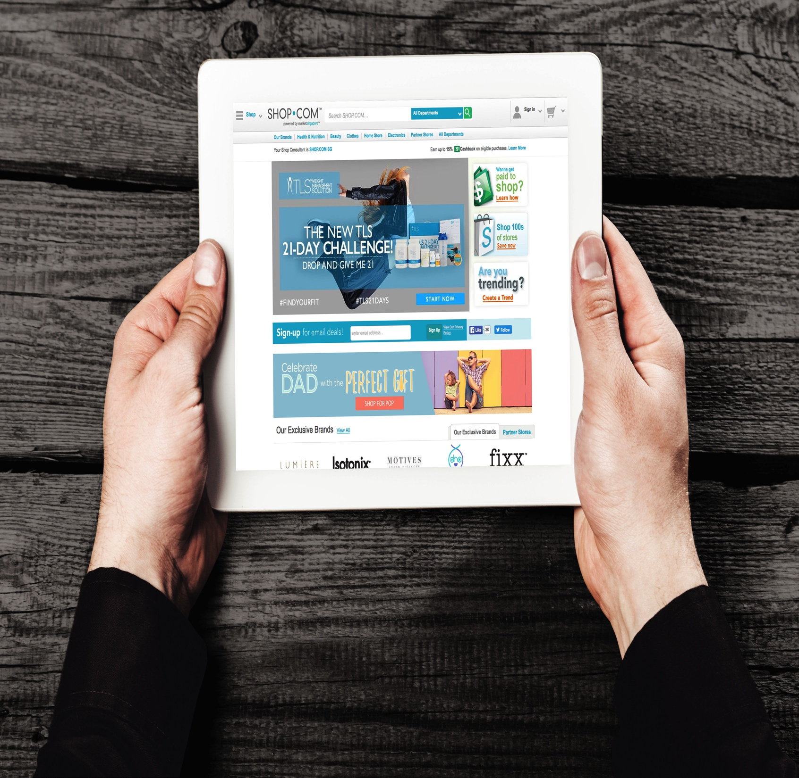


















Take “Business Spending Assessment”
Convert Business Overhead
into Income

Slide 21

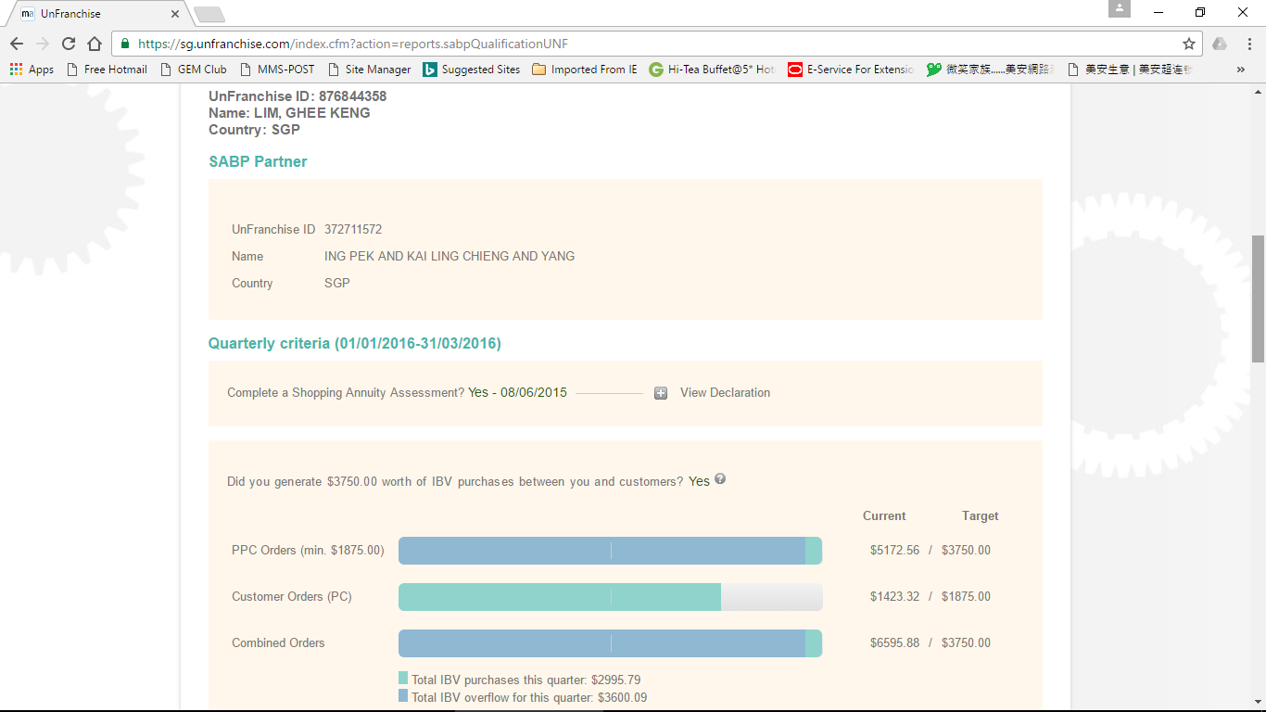
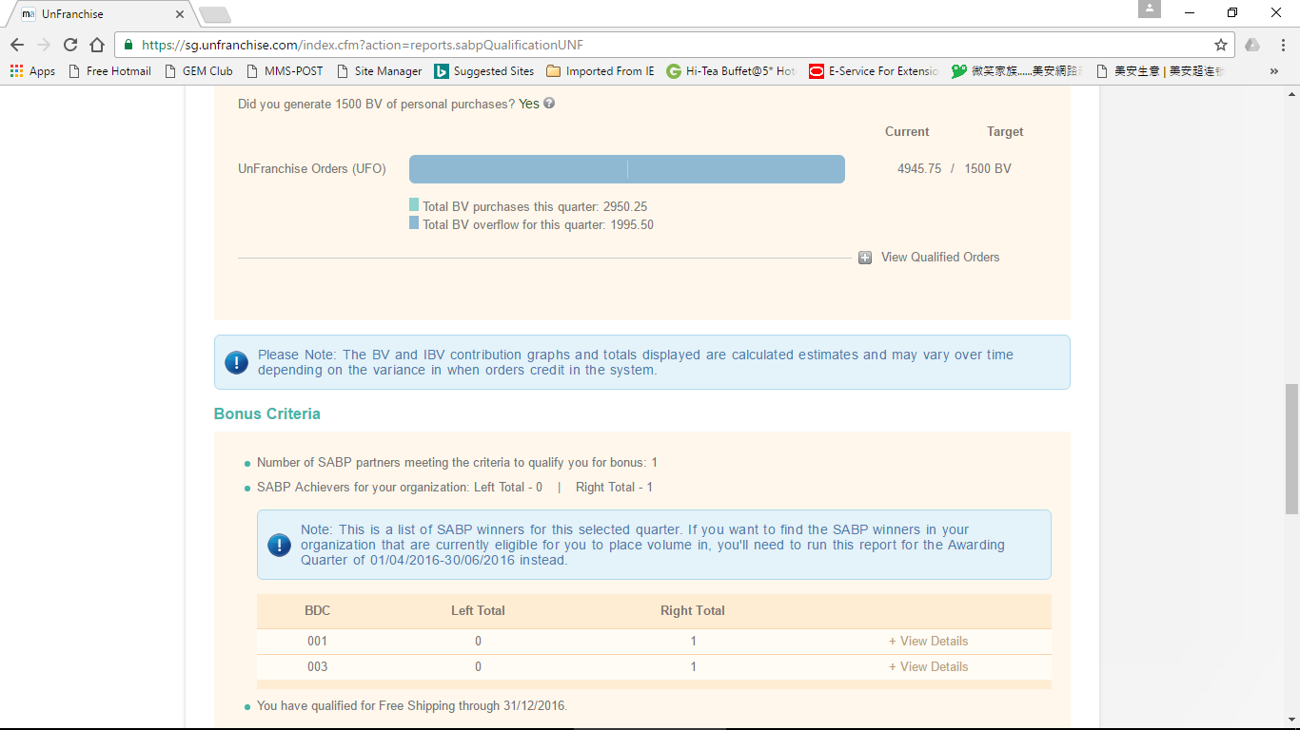
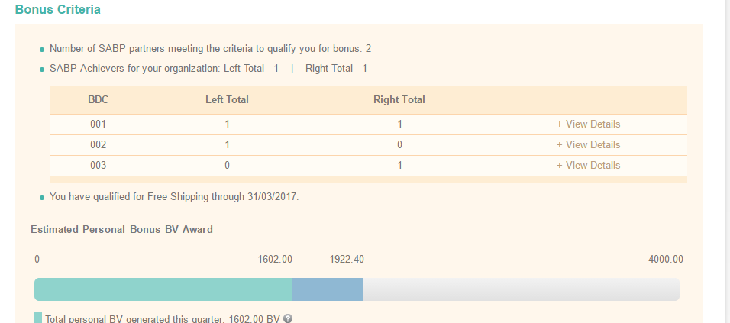
Notes:
I talk about as a wco I did achieve my SABP, and my team member also affected by me also doing SABP, and in the new quarter, I have more team member achive SABP

Slide 22

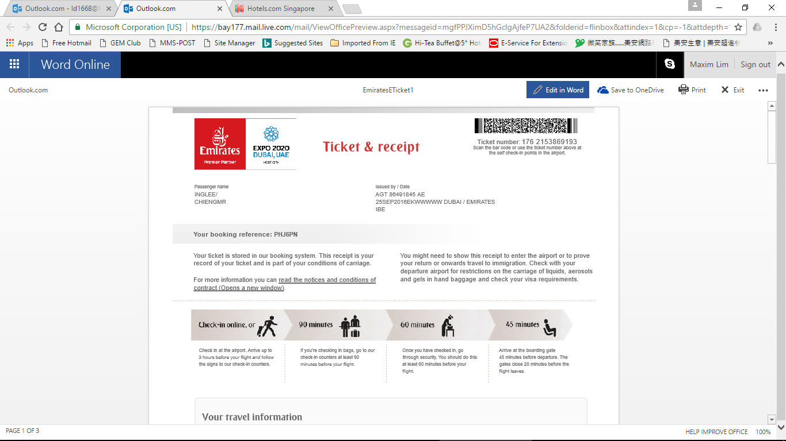
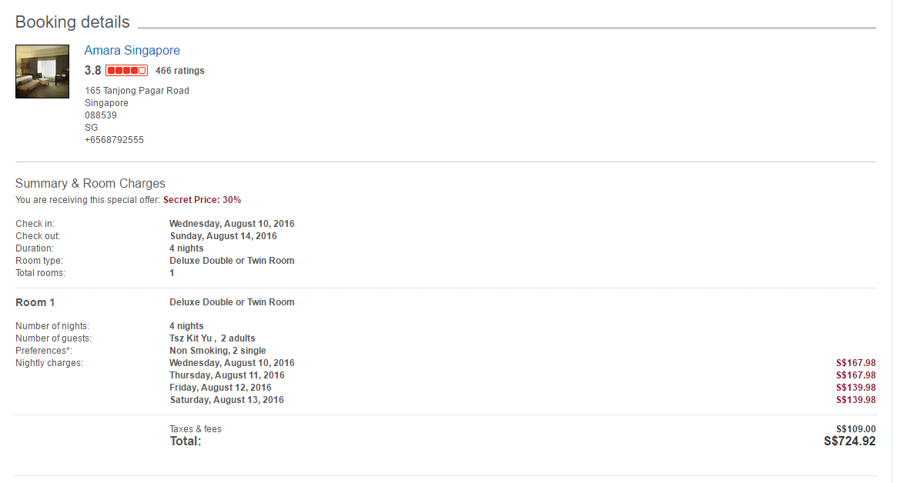
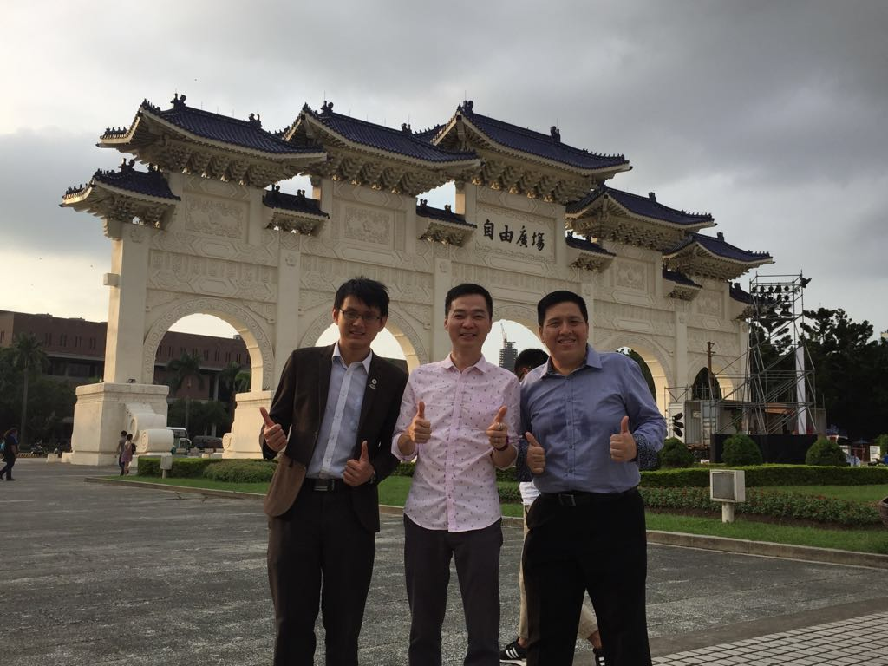
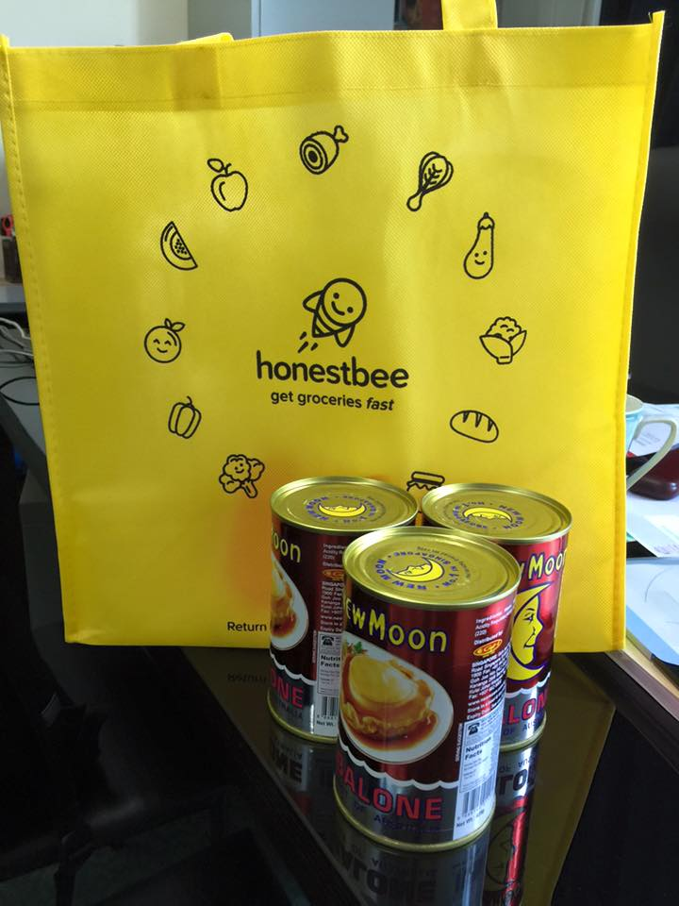
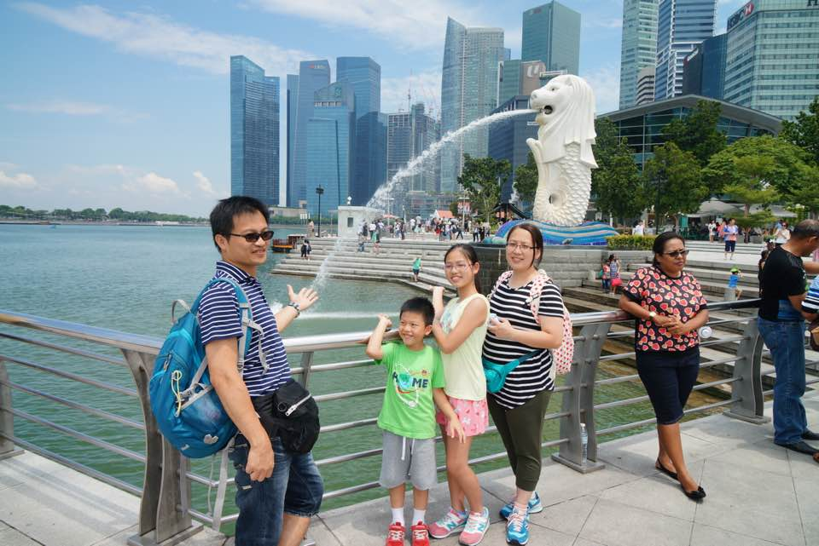
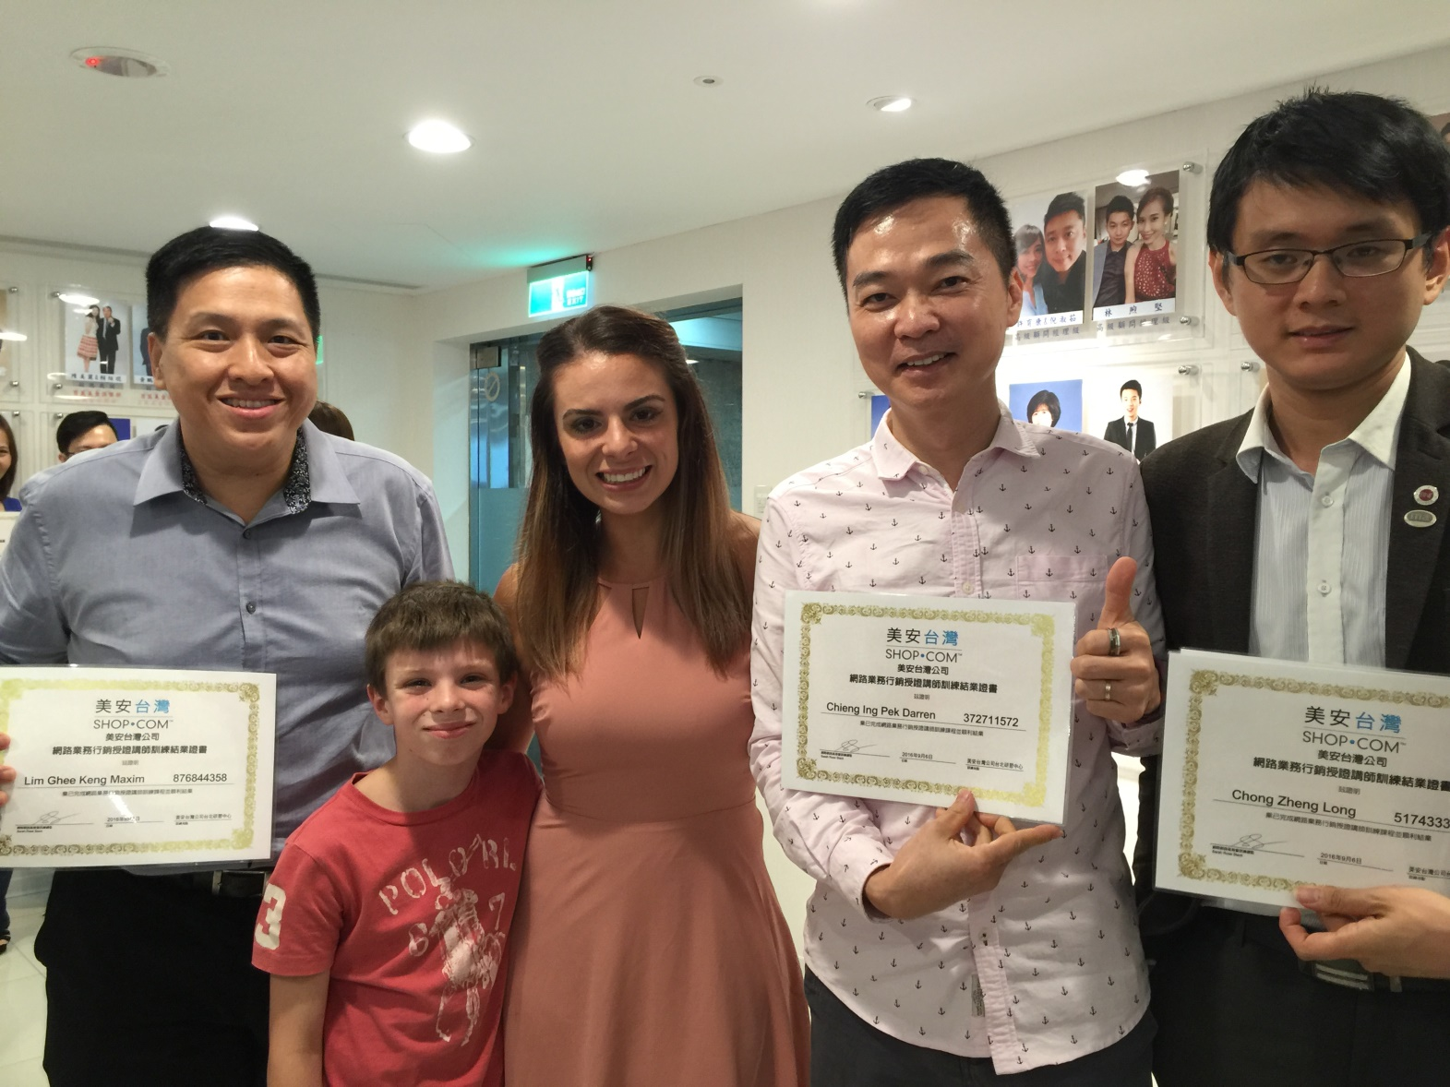
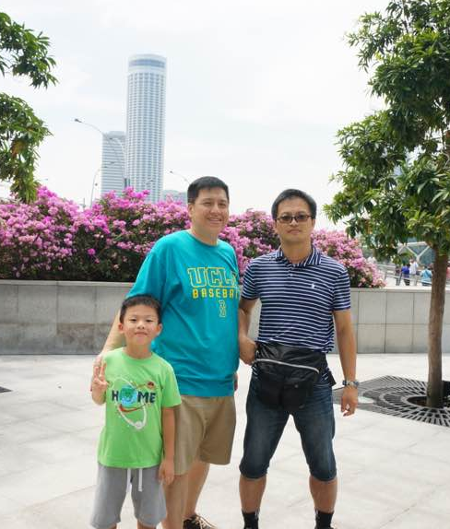
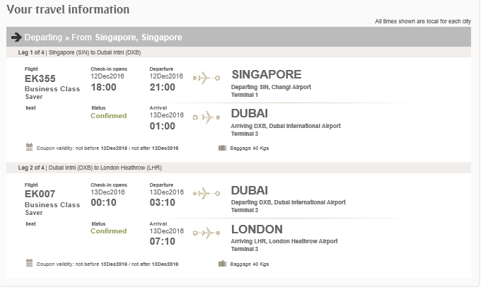
Notes:
I helping my HKG friend to plan his family trip to SG, he bought the tickets thru my online shop, I help him to book hotel and tourist attraction tickets. I also help my team leader and partner to book their local tourist attraction tickets (leverage!!!), I fly to taiwan for certify trainer training with my team mates, I buy my house groceries thru partner store too, I m so lucky, my Brunei webcenters’ client called up, requested me to buy air tickets and book hotel room for their holiday trip to UK and France in this coming Dec! So, who say WCO very difficult to do their SABP? I make it, you all also can make it happen.

Slide 23

WHAT IS YOUR NEXT STEP?
Get a webcenter!
Fast Start Kit
S$499
Includes :
S$164.95 Subscription,
300 BV &
Free Shipping

Slide 24
Thank You

